Slide 1
Introduction to Linux Systems Run Python Script on Carla
Chia-Heng Tu
Dept. of Computer Science and Information Engineering
National Cheng Kung University
Fall 2024

Slide 2
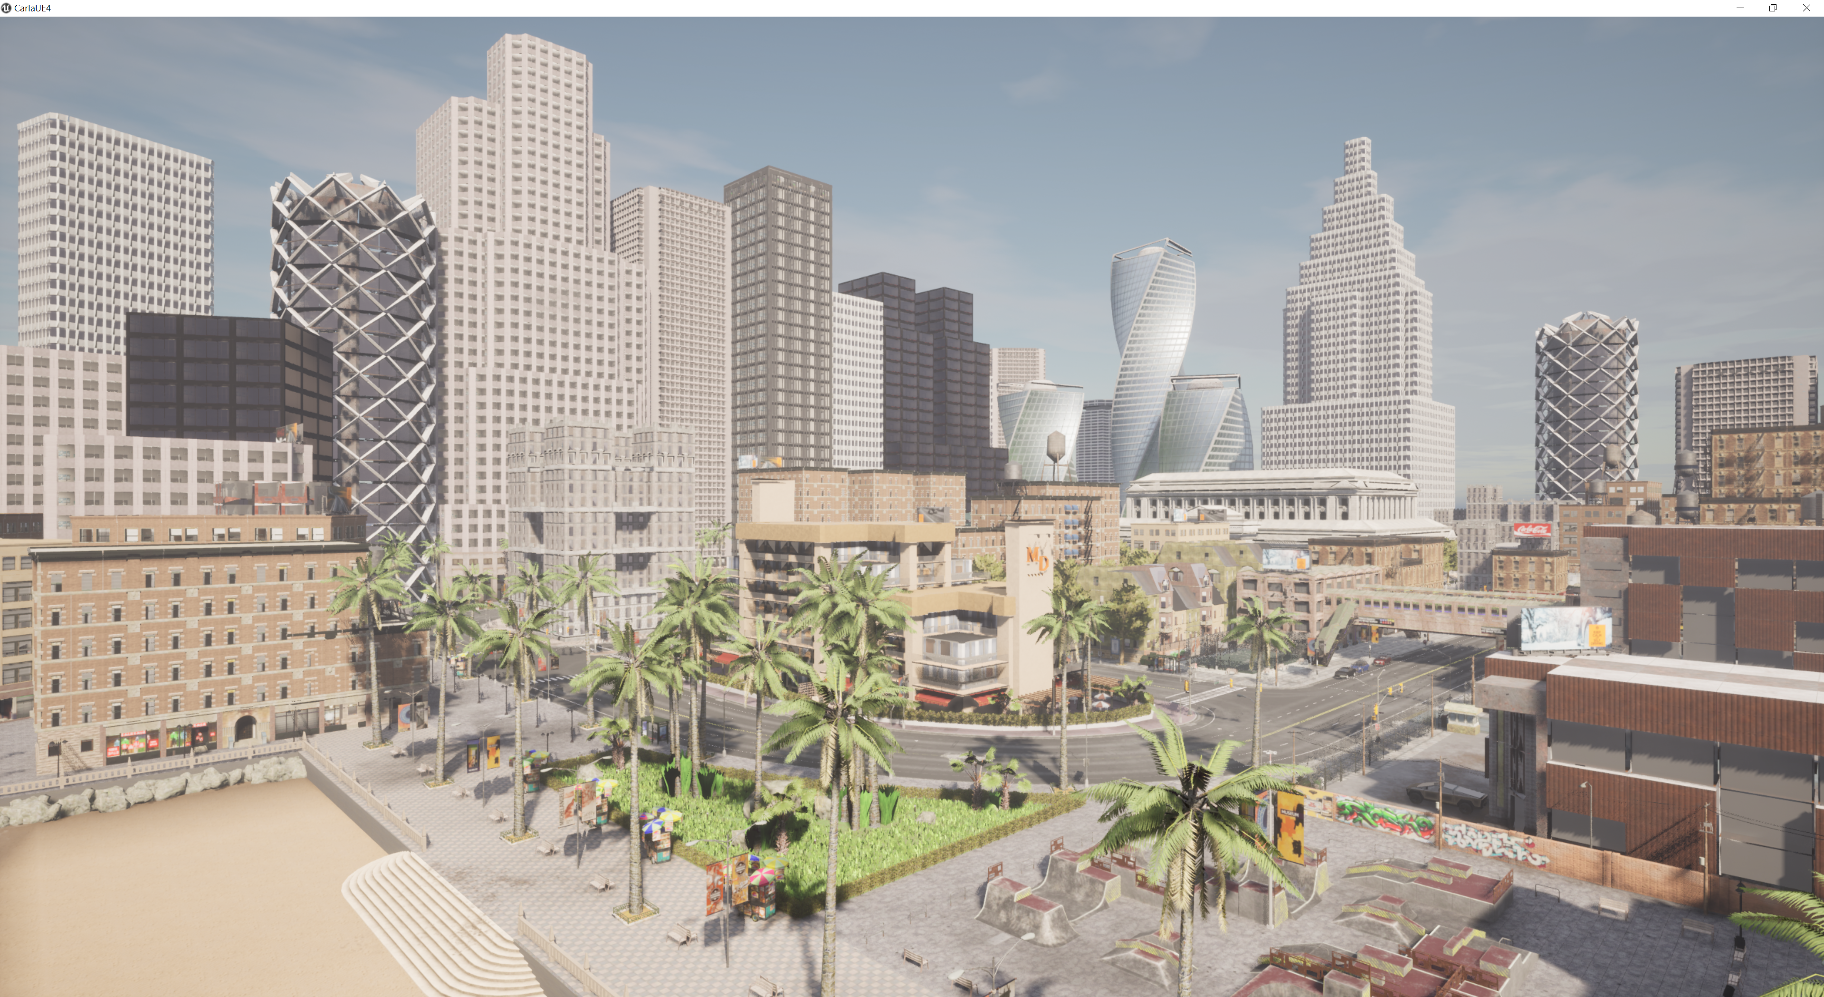
Download and Open Carla

Slide 3
Run Python Script
$ cd <path/to>/Carla
$ cd <path/to>/PythonAPI/examples
$ python –m pip install –r requirements.txt
$ python manual_control.py

Slide 4
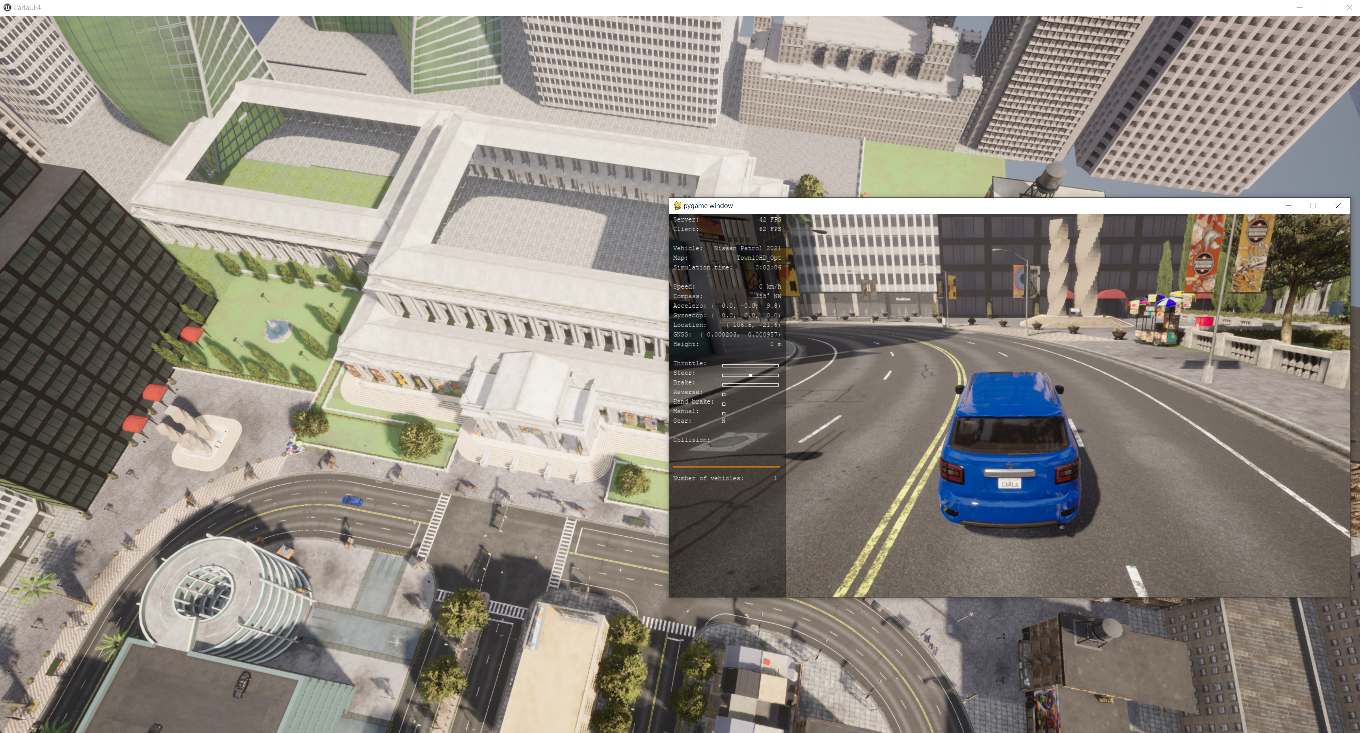
Manual_control.py
Pygame window open and a car generate.

Slide 5
Maunal Control Vehicle
Go ahead: enter W in pygame window
Turn left or right: enter A or D in pygame window
Reverse: enter Q then enter W in pygame window
Gear (換檔): enter , or . in pygame window
Toggle Autopilot (自駕): enter P in pygame window

Slide 6
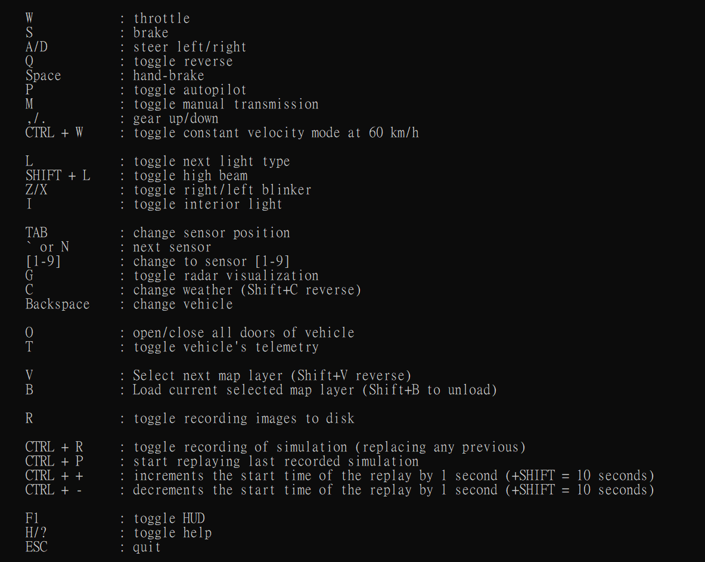
Manual_control.py operation
More operation you can check this table

Slide 7
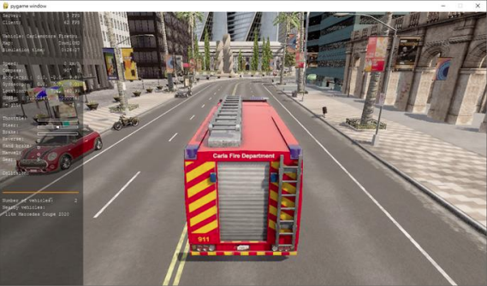
Manual_control.py change vehicle
$ python manual_control.py --filter="vehicle.carlamotors.firetruck"

Slide 8
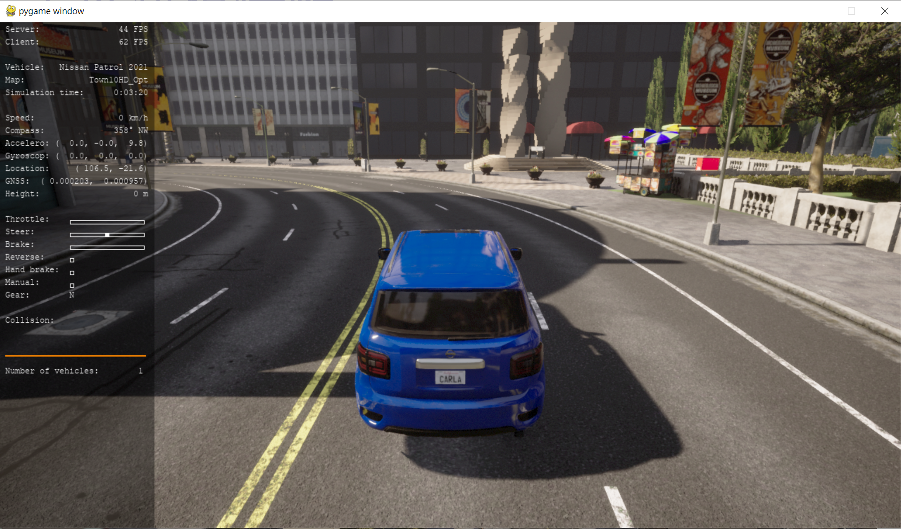
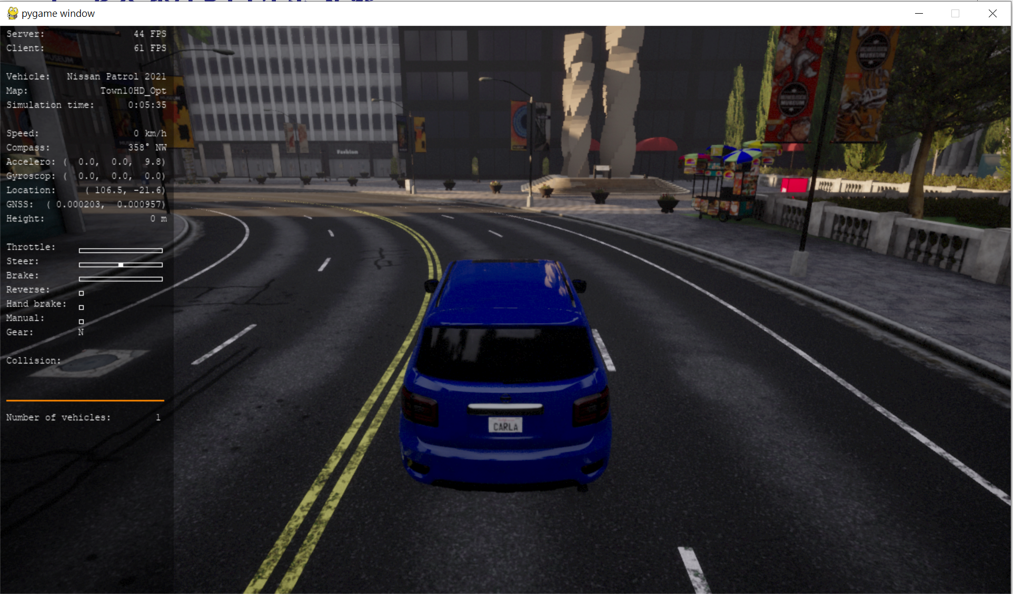
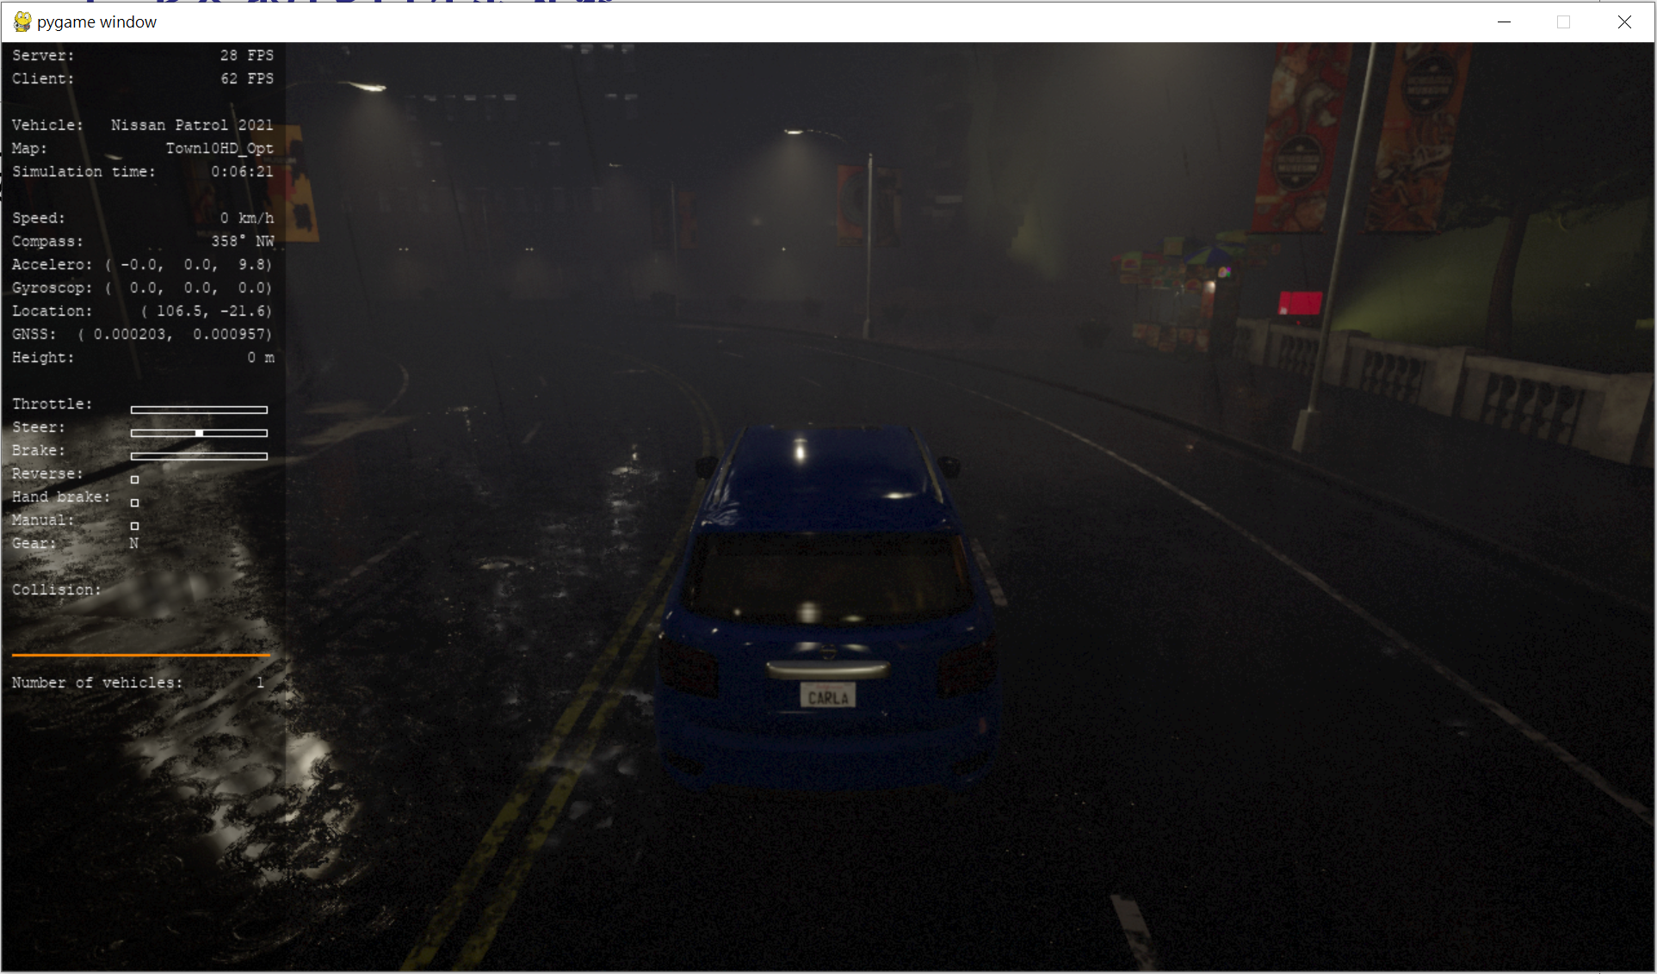
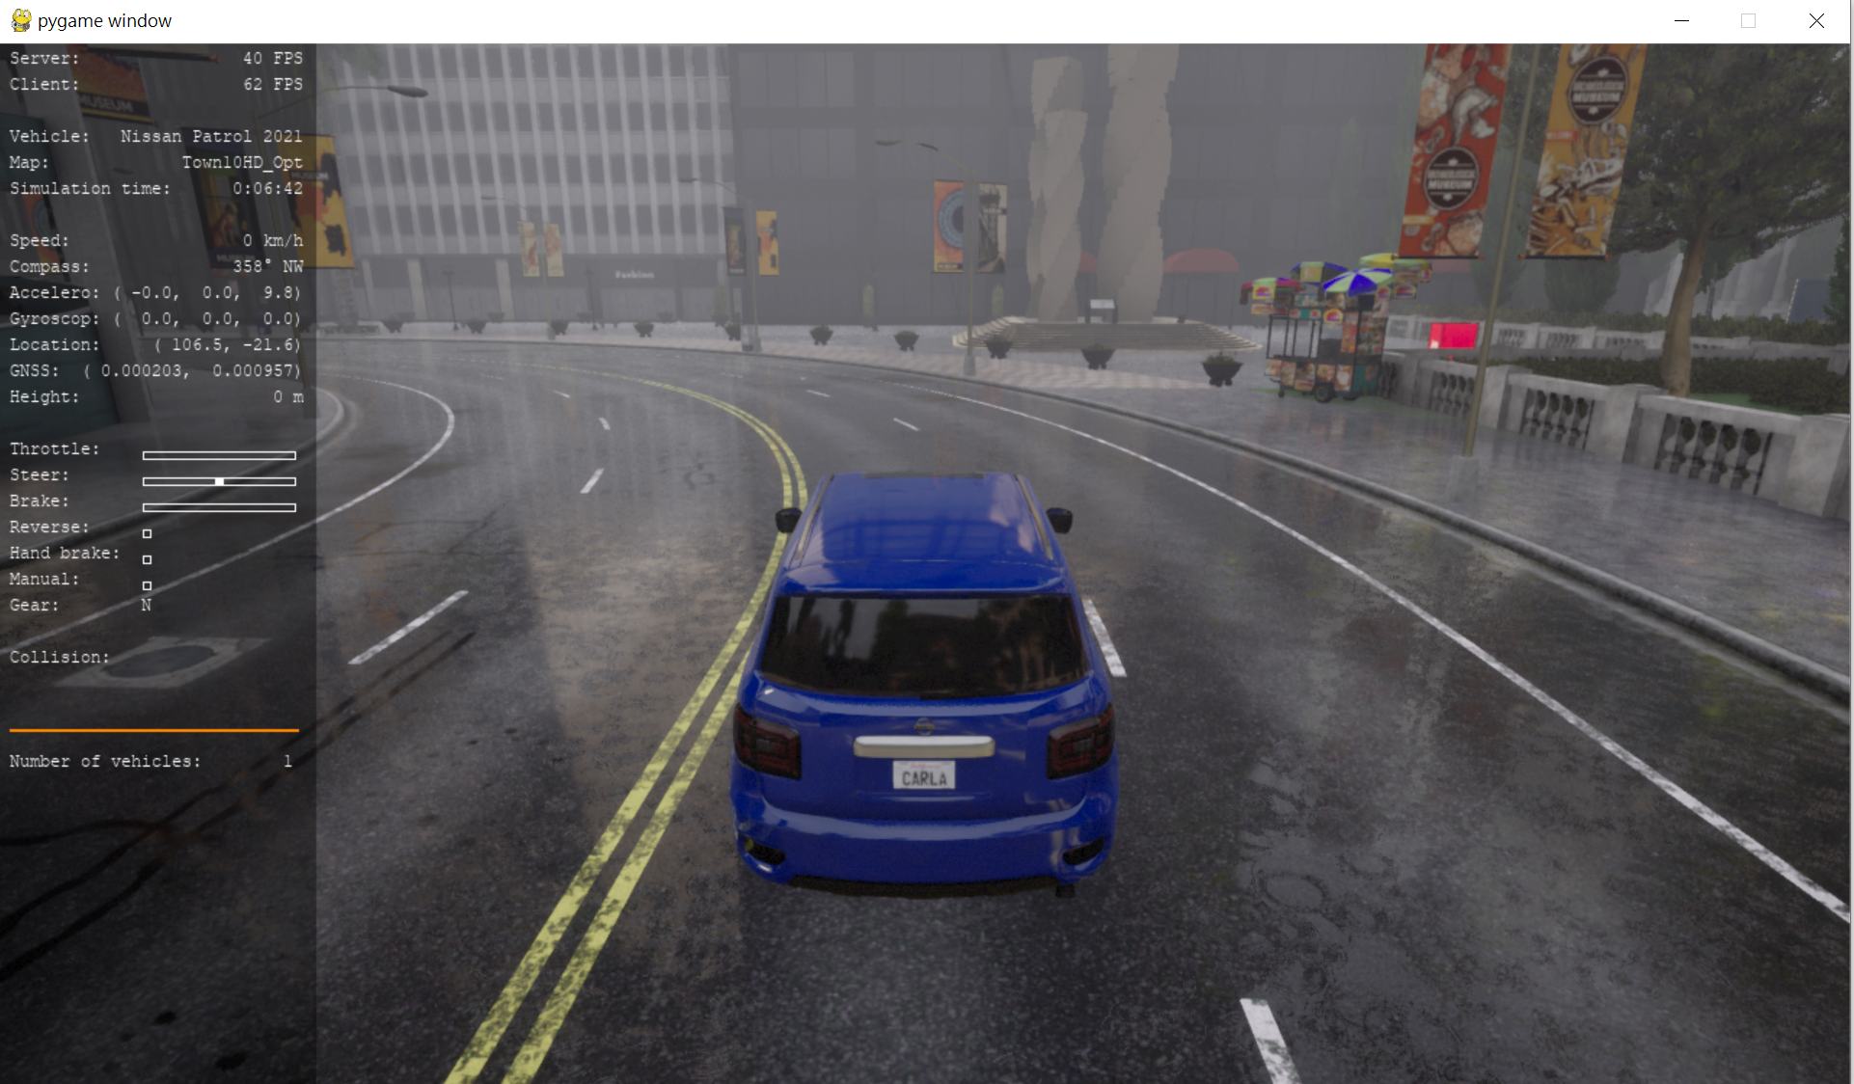
Weather
Total 22 weathers

Slide 9
Change to Specific Weather
When entering C or Shift + C in pygame window, you need to change to specific weather. The index of specific weather is last two number of your student ID % 22
You should only modify the code in manual_control.py
Hint: next_weather

Slide 10
Demo
手動控制 (manual control) 車輛模式錄影(5秒)
自動控制 (autopilot) 車輛模式錄影(5秒)
修改天氣程式碼並截圖修改的部分
請生成指定車輛來進行錄影
以上檔案放入同一資料夾後包含心得一起壓縮上傳 moodle

Slide 11
Notice
因為 Carla 對顯示卡的要求較高，若同學在自己的電腦上無法成功執行，可以填寫時間表到實驗室借用電腦

Slide 12
QUESTIONS

